Slide 1
Shree Pashupati Secondary school
Bahradashi-3,Jhapa,Nepal
Voice Calculator
TEAM MEMBERS:-
SISIR B.K
LEEZA PRASAI
NIMEESHA RIMAL
SUMAN SHRESTHA

Slide 2
Introduction
This is our first project .We want to thank all teachers for their proper guidance and support . We appreciate their proper guidance and support towards us and we want to thank our classmates who had supported us ,encouraged us .
We had made voice calculator as a first project of grade 11. For making this project we had studied each topic that is used in our project.
The project that we had developed is web-based project.

Slide 3
We had used Speech Recognition feature using web speech API as well as in this calculator we can calculate sin , cos, tan ,square root ,cube root , whole square , whole cube ,reminder as well as other simple calculations like add , subtract , divide , multiply manually through keyboard. We can also know the value of PI in this calculator.
We can add, subtract ,multiply and divide value through voice input.
The value that user has given to our calculator is evaluated by calculator and displayed in text box .When result is printed in text box ,the input that is provided to calculator and output that is printed in text box is provided to user as voice output as well as text output.

Slide 4
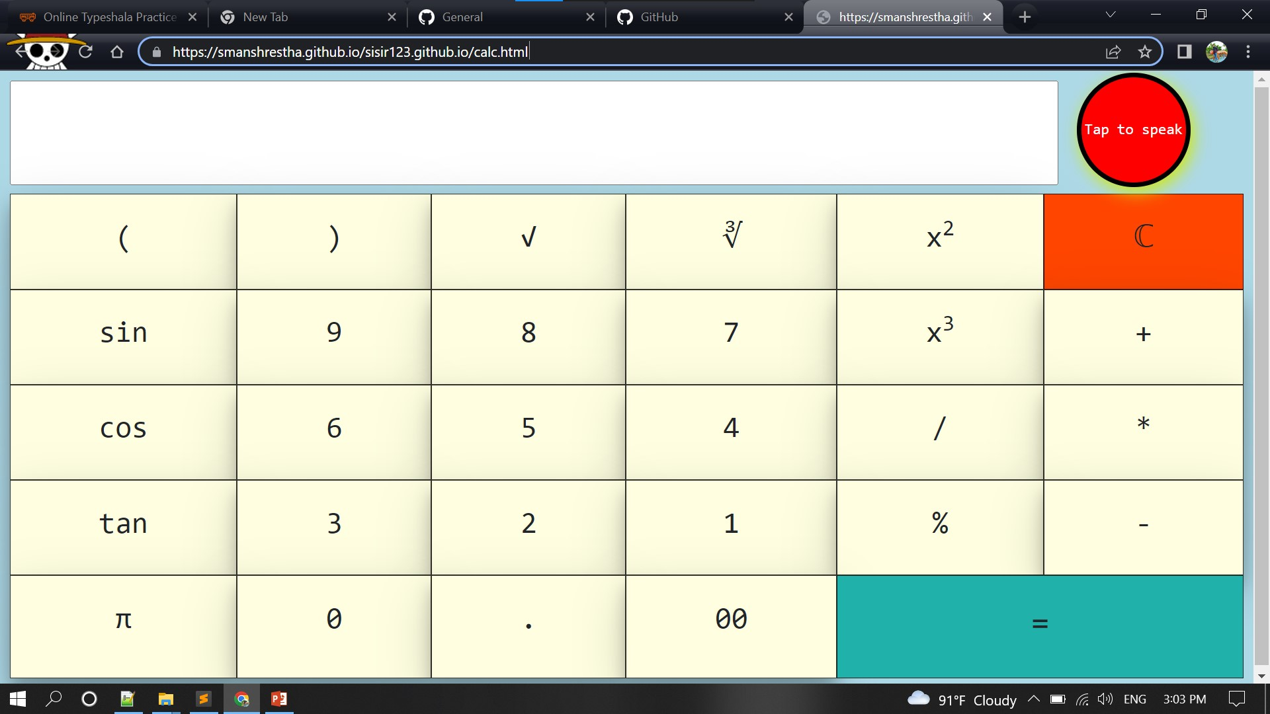

Slide 5
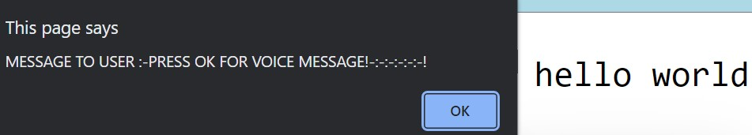
If user gives wrong voice input like (hello world or any thing else which is not a mathematical expression) then , One Message is provided to user i.e. shown in fig
below:-
And when user clicks on OK button then VOICE Message is given to the user.
Like “the expression(#input) is incorrect ,perhaps it is not a mathematical operation , please try again and give clear voice input.”

Slide 6
We can use speech recognition of our project by just pressing the mic button and by speaking the expression (for example: 75 plus 10 plus 5 = 75 + 10+5 =90 ): it will appear on screen and the result will be calculated..
Merits of our project:-
We can use speech to text and text to speech in real-time.
We can performs the simple calculations with the help voice command .
We can get output result through voice by using speaker of devices.
Voice commands are more efficient than typing numbers for calculation.
Helpful for those peoples who have problems with eye sight . Mean that they can calculate their calculations by speaking as well as they can listen their input and output result for their satisfaction.

Slide 7
Limitations of our project:-
1. Our project is web-based calculator but it is less responsive. (We tried to make our project responsive using @Media Query and Bootstrap but unfortunately our code didn’t respond so we decided to remove all those media queries) .This is main disadvantage of our project.
2. Our calculator cannot perform advance mathematical operation through keyboard input.
3. Speech Recognition is not supported in older version of Google chrome .
Unexpectedly ,We cannot perform advance calculation through Speech Recognition .
Lack of Natural language processing (NLP):-It cannot understand human language as it is spoken and written.
Less efficient.
Our calculator needs internet access .Without internet it cannot be operated.

Slide 8
For this project we have used the following things : Sublime text :-
we have use sublime text as code editor and wrote all code in this code editor.
HTML:-
Hyper Text Markup Language is the code that is used to structure a web page and its content.
CSS :-
Cascading Style Sheets is a stylesheet language which describes how HTML elements are to be displayed on screen or in other media .
JavaScript: -
It is a text-based programming language. It is used by programmers across the world to create dynamic and interactive web content. It is the most used programming language in the world, used as a client-side programming language by 97.0% of all websites.

Slide 9
Web API:-
API stands for Application Programming Interface. A Web API is an application programming interface for the Web.
Web Speech API:-
The Web Speech API provides two distinct areas of functionality like speech recognition and speech synthesis (also known as text to speech, or TTS) which open up interesting new possibilities for accessibility, and control mechanisms.
Speech recognition:-
Speech recognition involves receiving speech through a device's microphone, which is then checked by a speech recognition service . When a word or phrase is successfully recognized, it is returned as a result (or list of results) as a text string, and further actions can be initiated as a result.

Slide 10
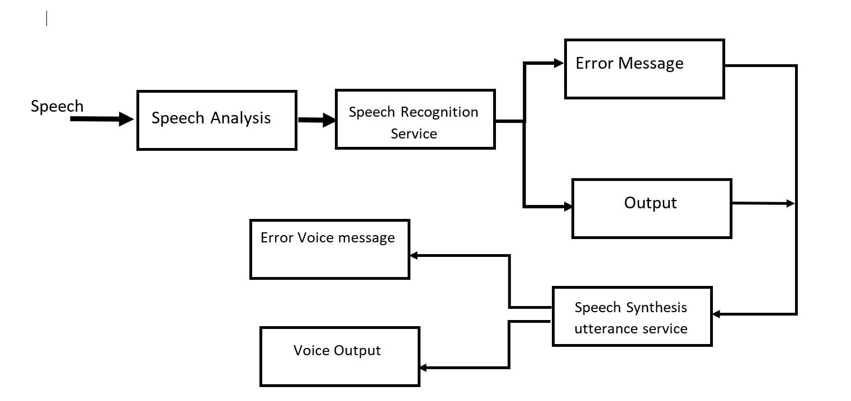

Slide 11
We can use our website using the link given below:-
https://smanshrestha.github.io/voicalcpashupati.github.io/calc.html
We used GitHub pages for hosting our website.
GitHub Pages is a static site hosting service that takes HTML, CSS, and JavaScript files straight from a repository on GitHub.
We can host our website for free , including custom domain names(https://pashuhpati.xyz), sub-domain (https://blog.pashupati.xyz) and provides secure(https) web hosting . But GitHub Pages sites shouldn't be used for sensitive transactions like sending passwords or credit card numbers.

Slide 12
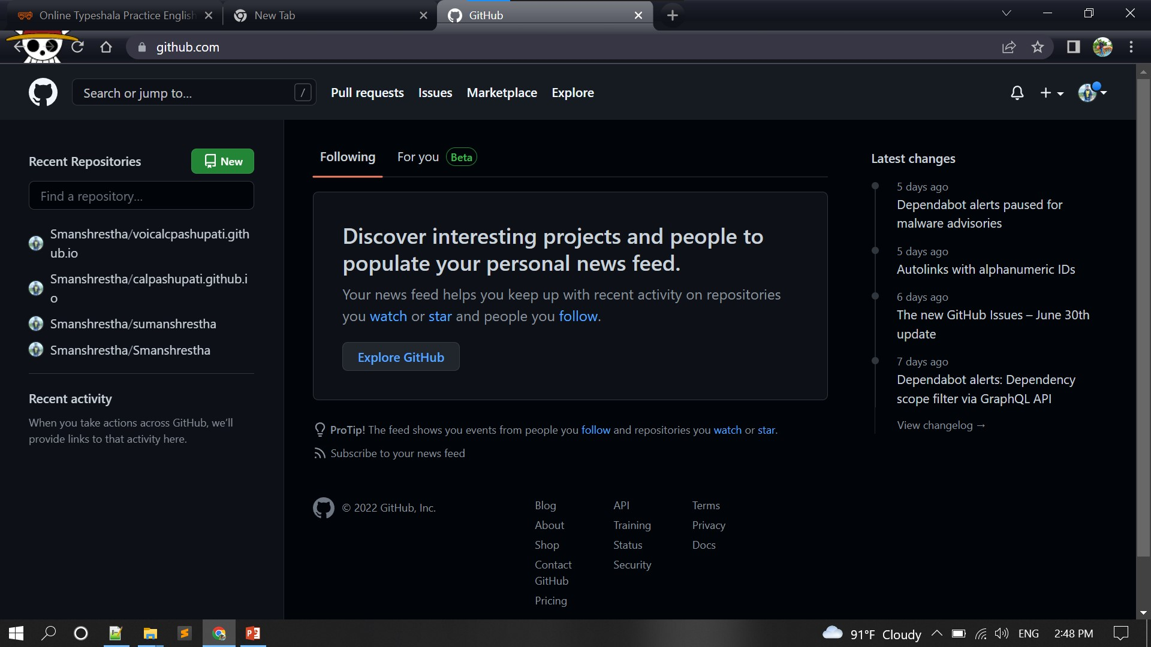

Slide 13
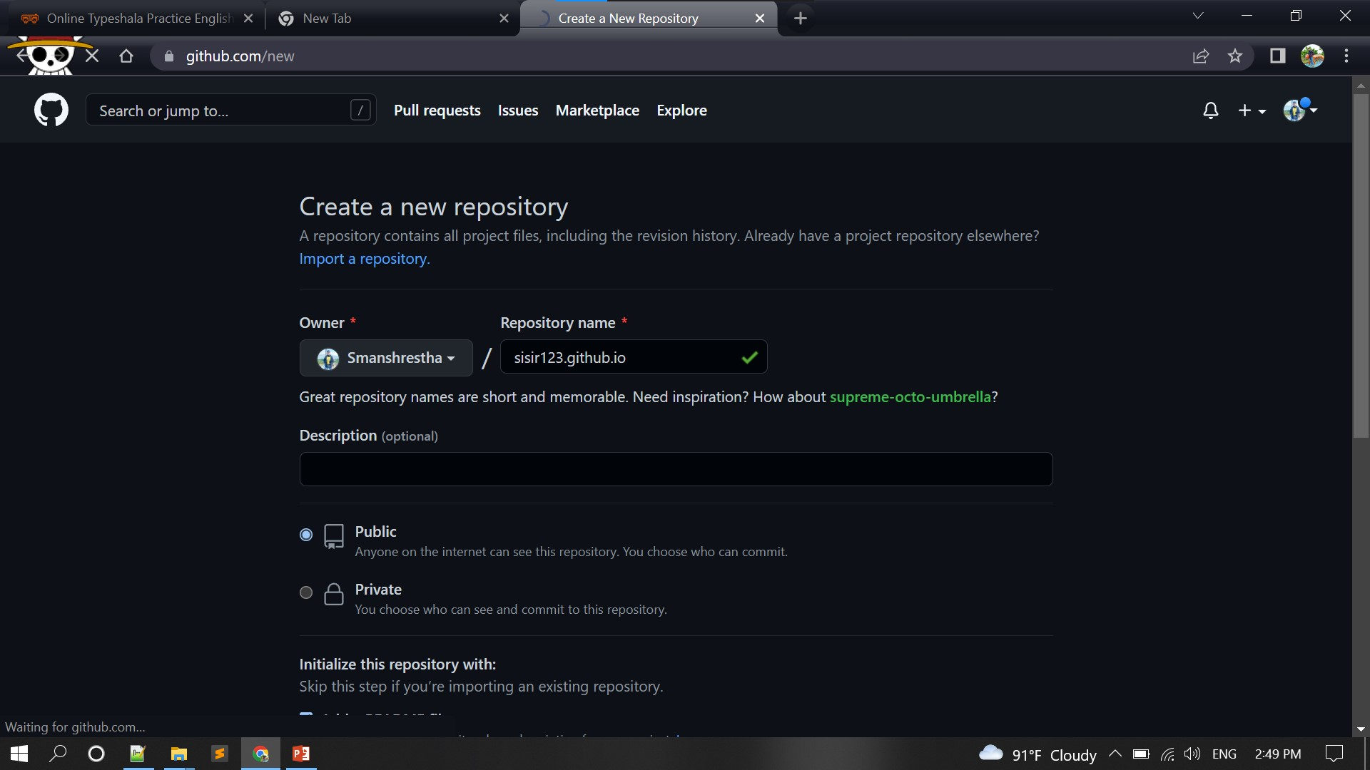

Slide 14
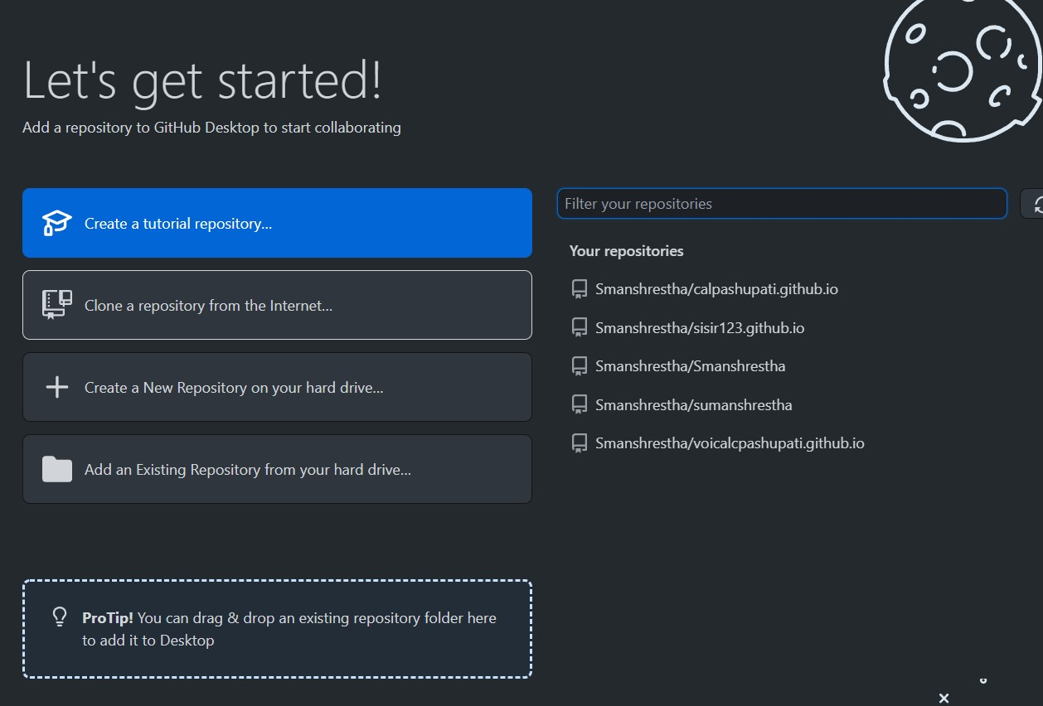

Slide 15
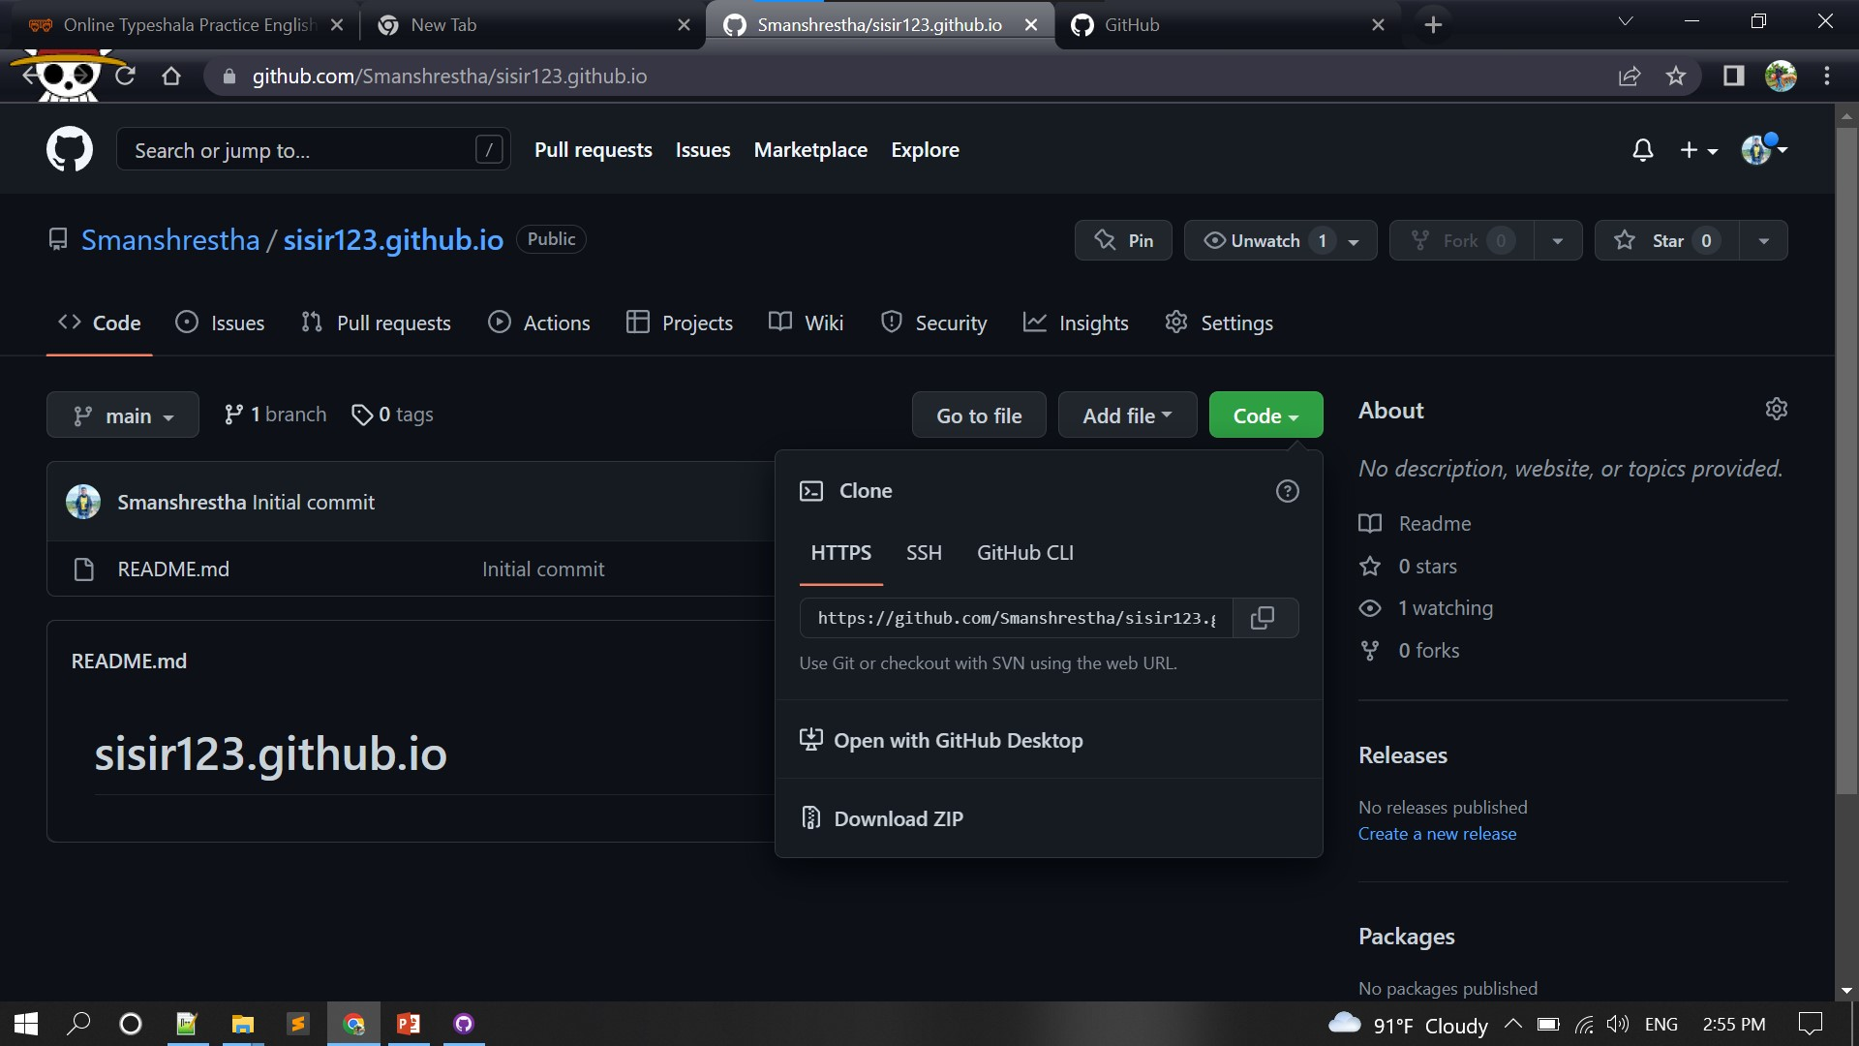

Slide 16
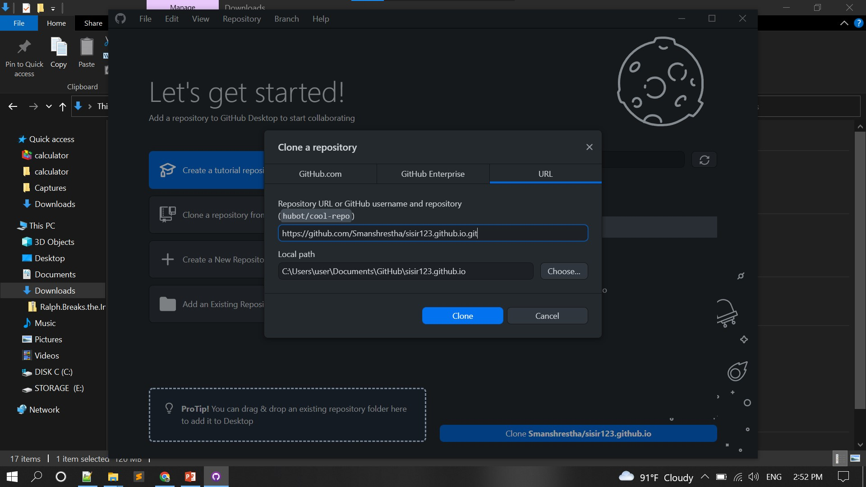

Slide 17
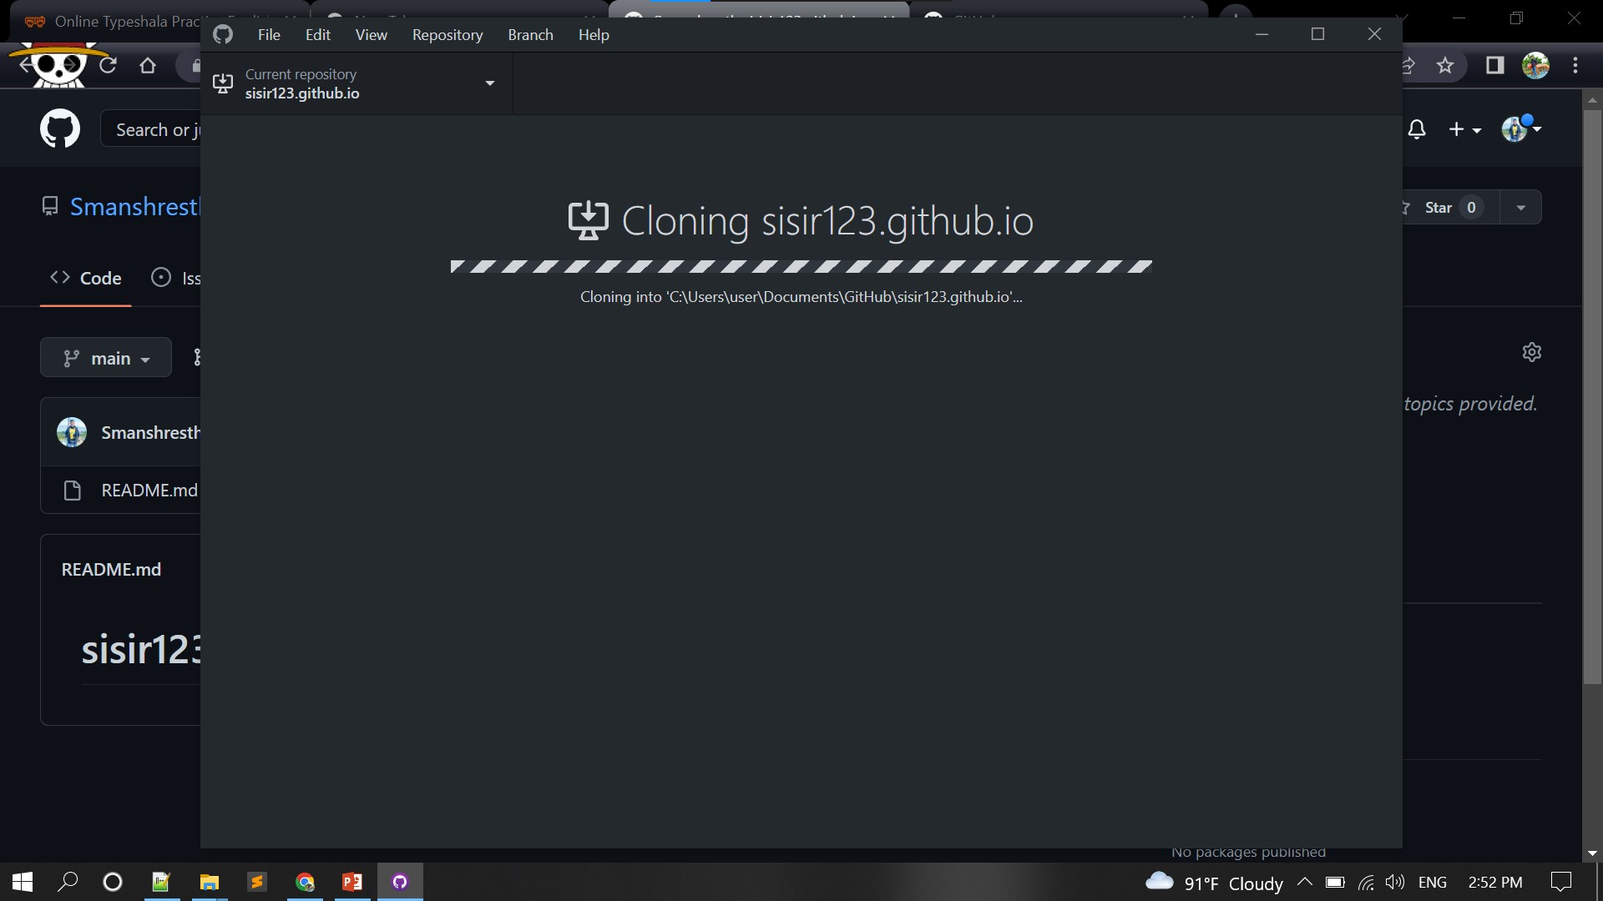

Slide 18
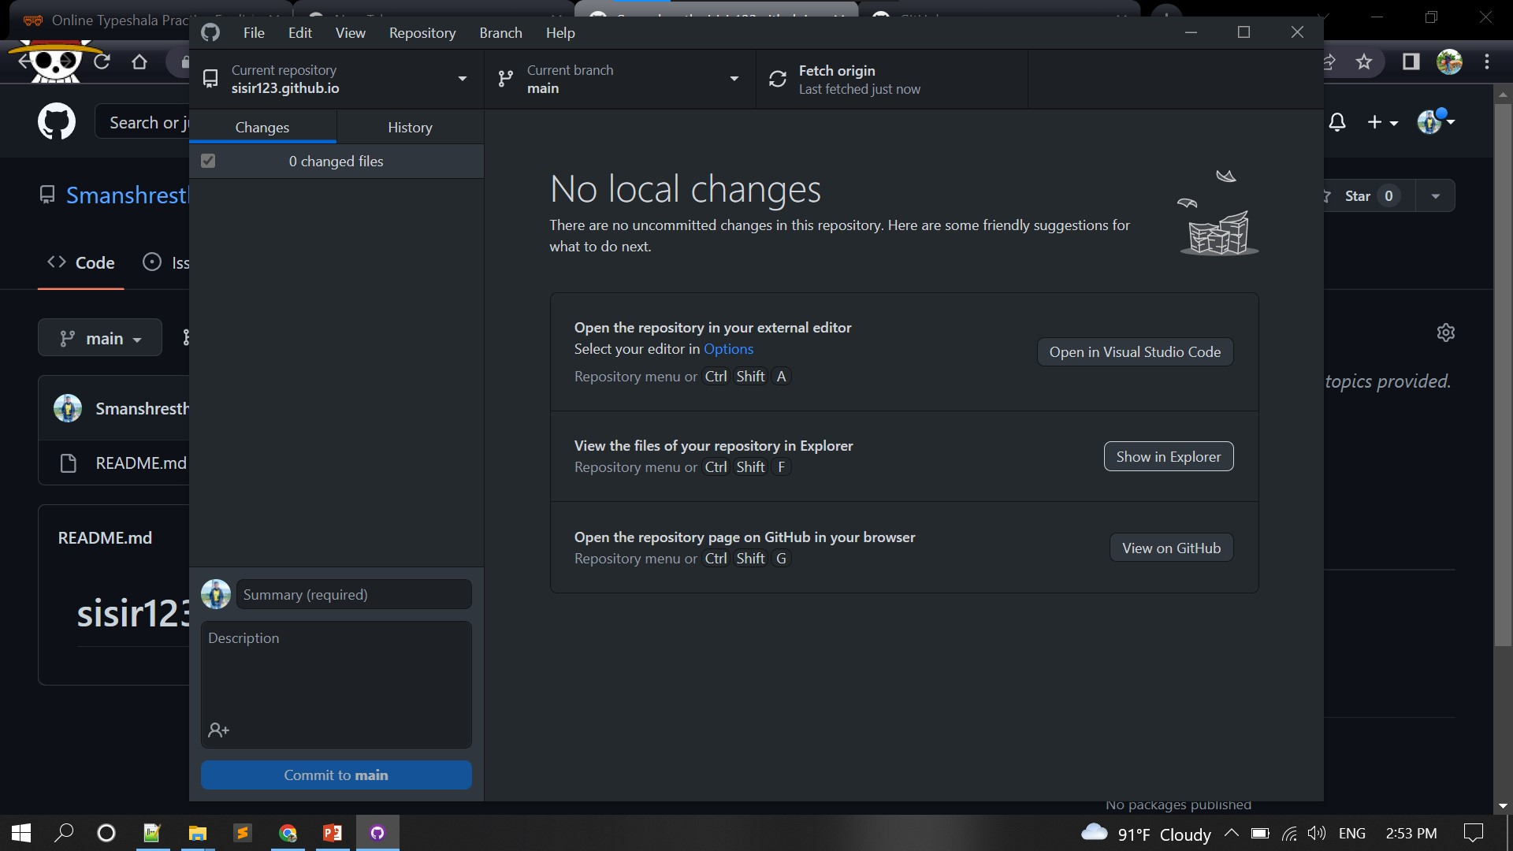

Slide 19
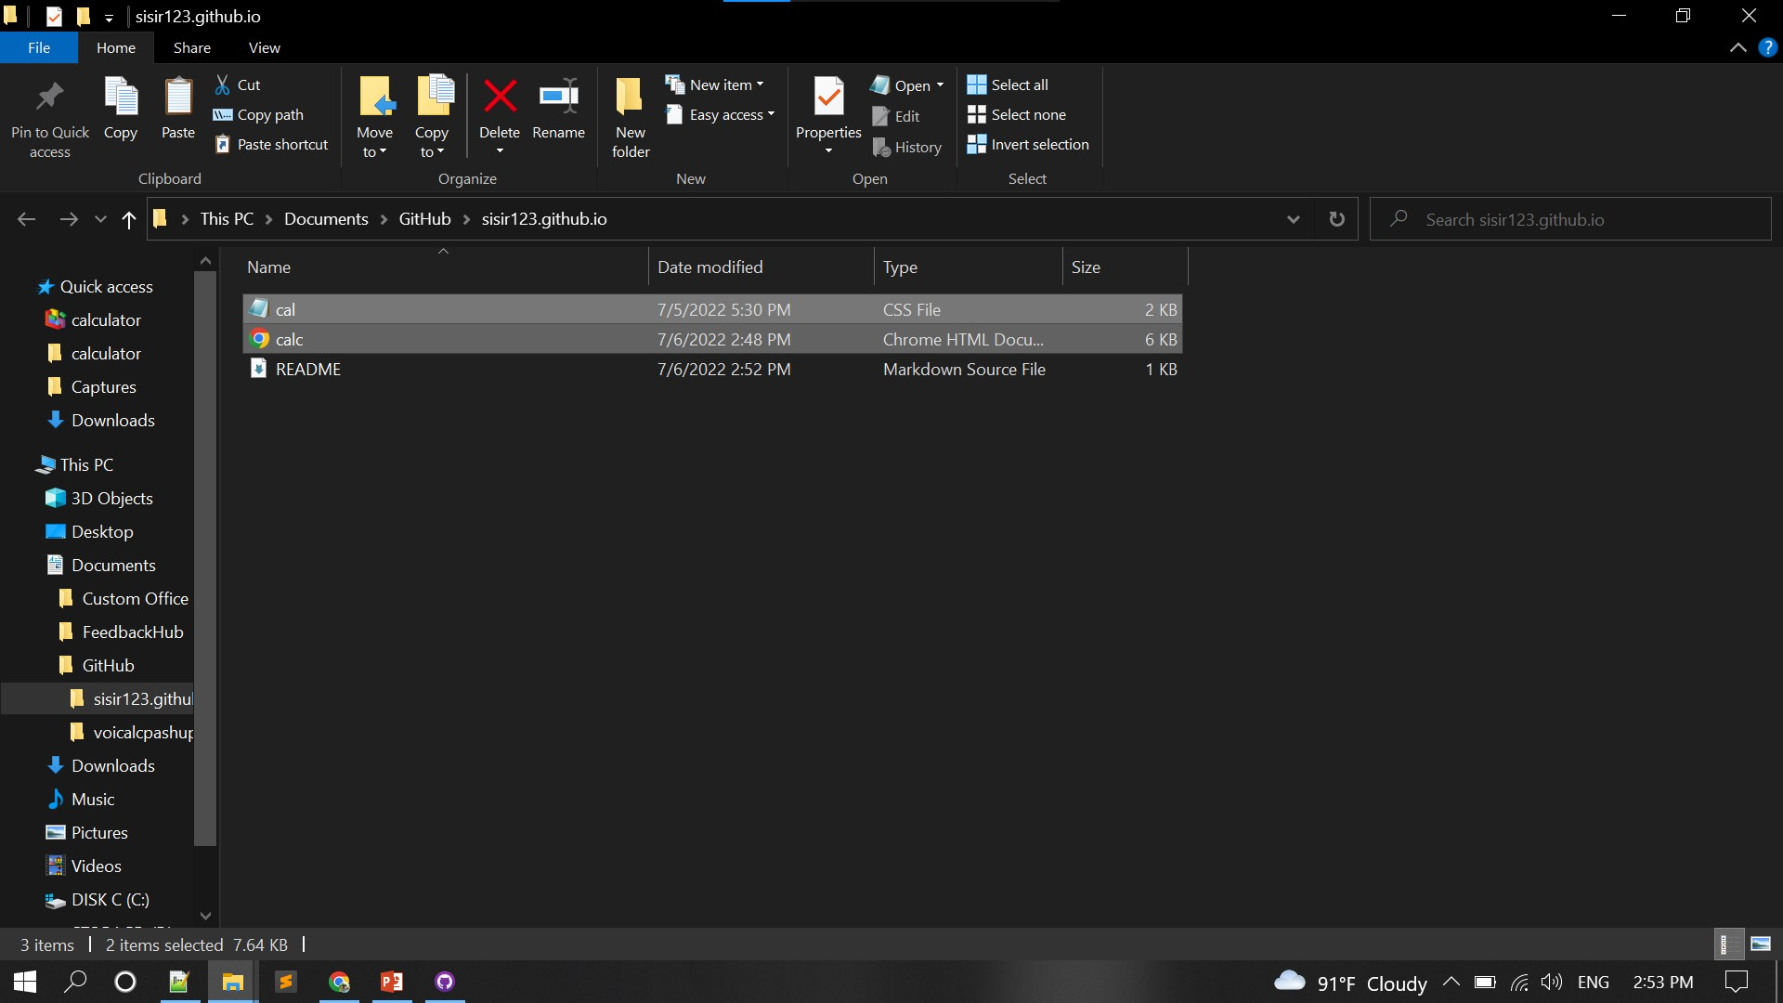

Slide 20
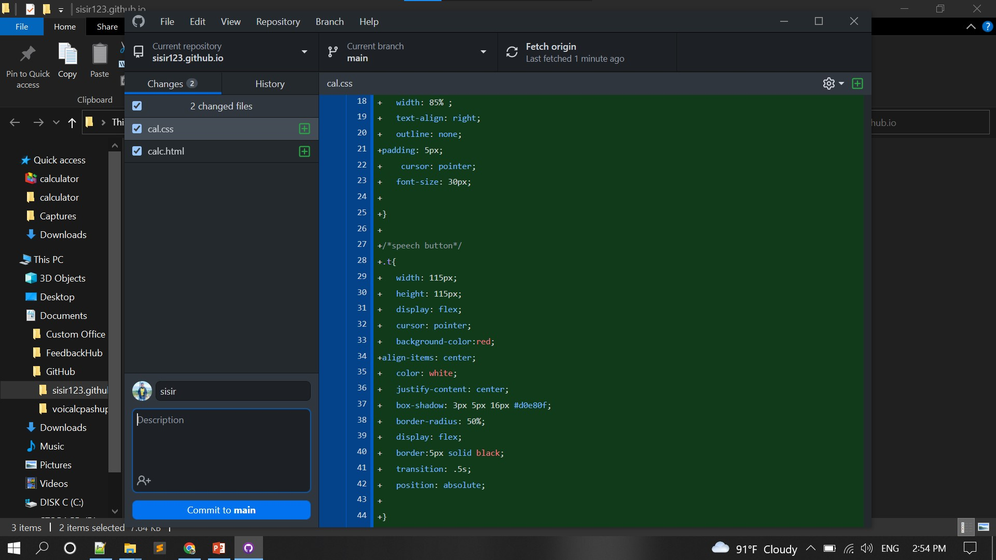

Slide 21
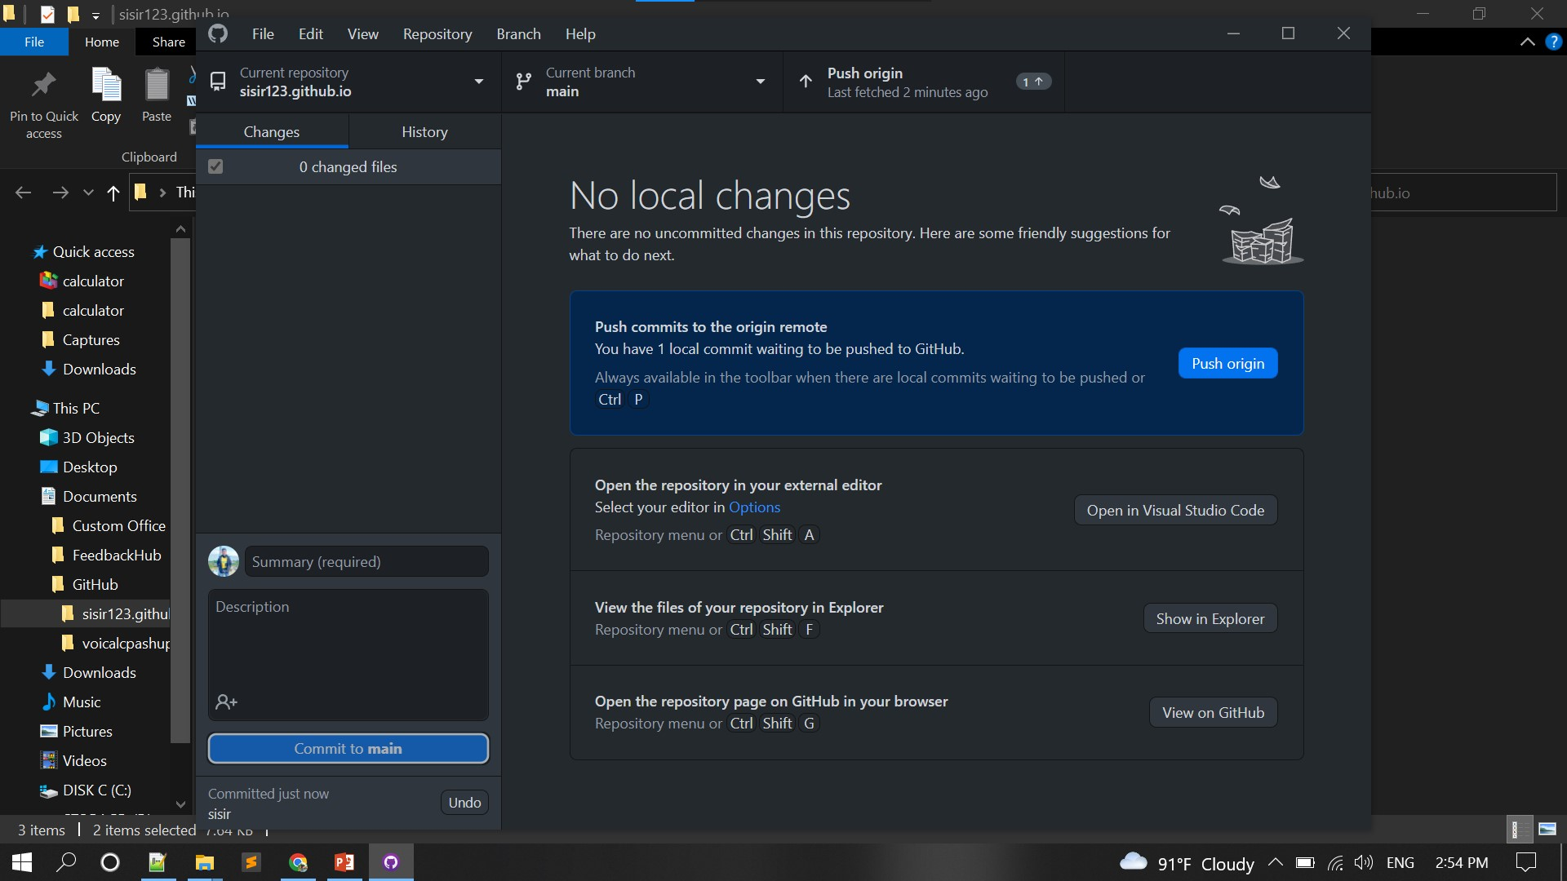

Slide 22
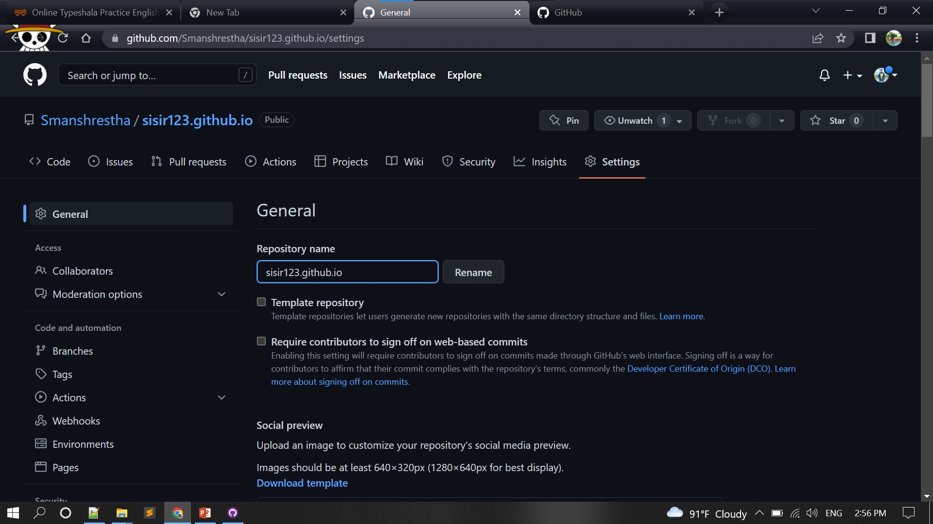

Slide 23
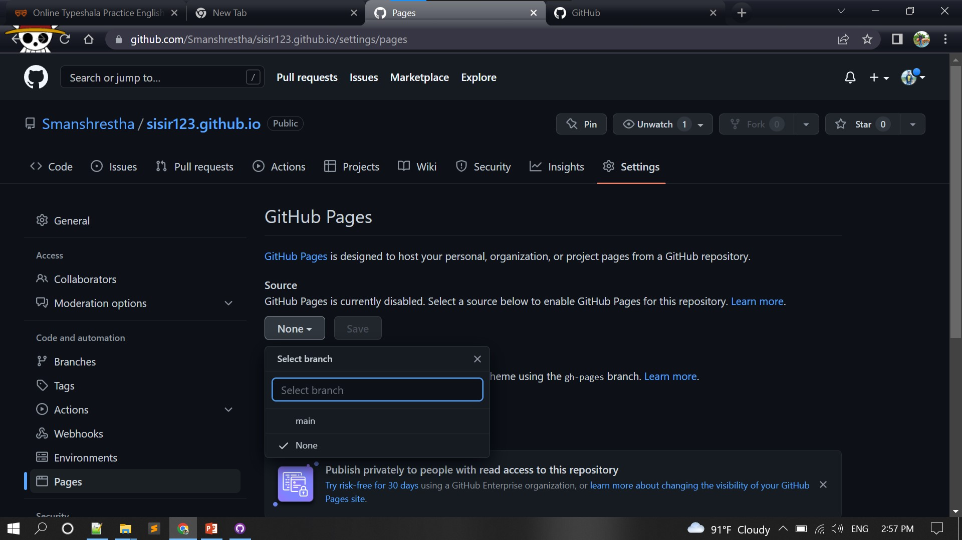

Slide 24
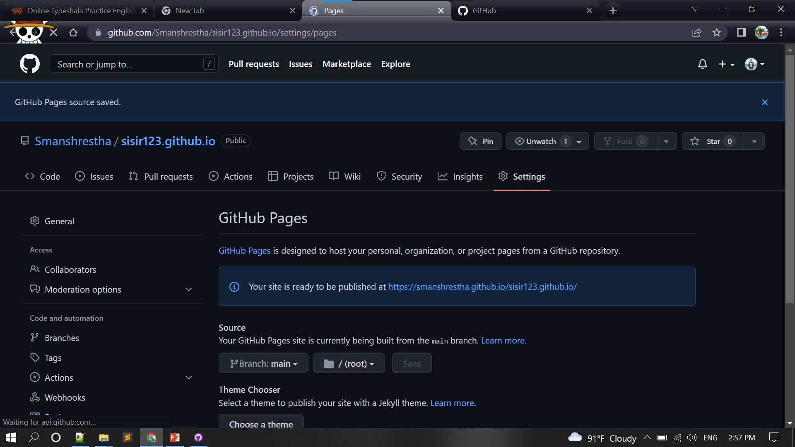

Slide 25
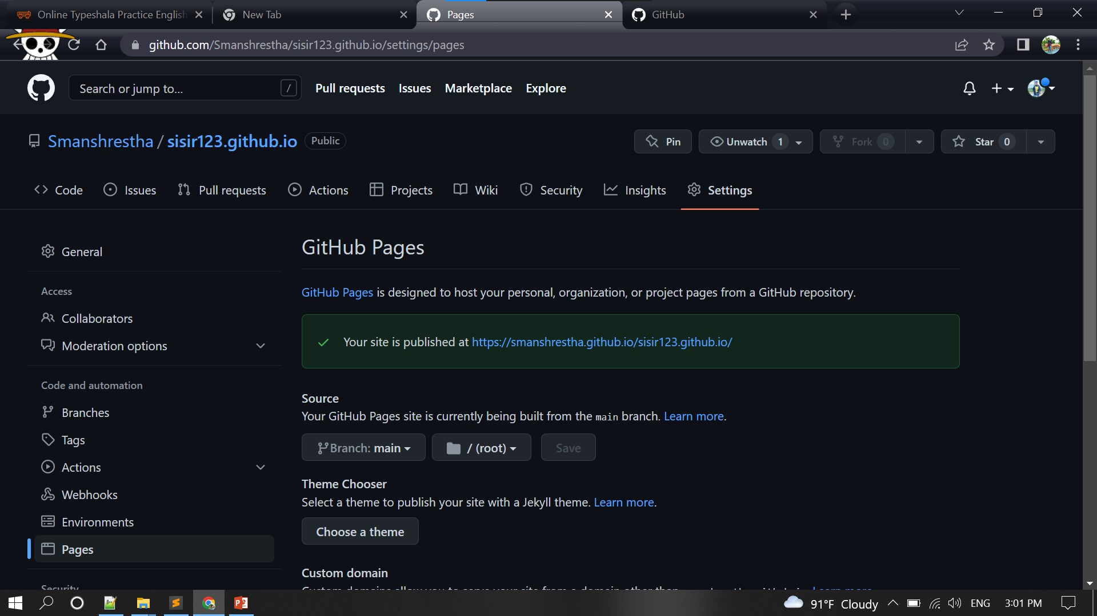

Slide 26
we should add (file name. html) at end of link that GitHub has provided to us.
Suppose (https://smanshrestha.github.io/voicalcpashupati.github.io/) is link provided by GitHub then (https://smanshrestha.github.io/voicalcpashupati.github.io/calc.html ) file name should be added for accessing website.

